Slide 1
securityindustry.org/women-in-security-forum
A CAREER ROADMAP FOR FEMALE ATHLETES
HOW TO “WIN”
IN THE SECURITY INDUSTRY

Slide 2
Excel in the Right Position to Match Your Skills
Playing Fields of the Security Industry
GOOD GAME
Whether just starting out or a seasoned professional, the security industry has a job suited to your talent and future vision for “what’s next”. Check out some of the options and add to your career scoreboard.

Slide 3
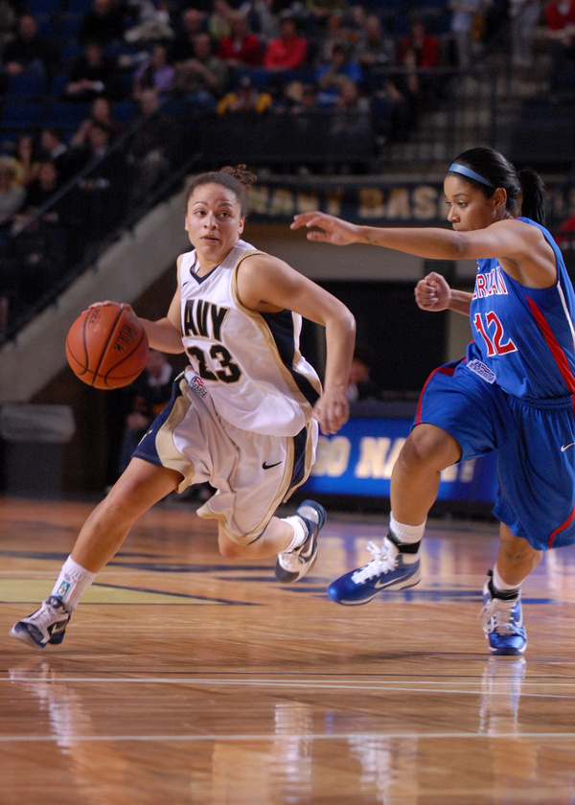
PROJECT MANAGEMENT
FRESHMAN
JUNIOR VARSITY
VARSITY
PRO
Project Lead
Project Coordinator
Project Administrator
Entry Level/Junior Project Manager
Security Project Manager
Job Manager
Installation Manager
Site Supervisor
Senior Project Manager
Program Manager
Director of Operations
Director of Program Management Office (PMO)
VP of Operations
SVP of Operations
VP Program Management Office (PMO)
SVP Program Management Office (PMO)

Slide 4
ABOUT THE FIELD (Project Management)
Salary Potential: $75,000 to $150,000 (plus bonuses) with more senior positions having an earning potential of $175,000+.
Work-Life Balance: Working hours (typical 40-50 hours per week) and travel requirements vary by company/role and complexity of the project/program. Project Managers may experience increased workloads when dealing with challenges or bringing projects to completion.
Requirements: Educational and on-the-job experience requirements vary by role. A degree in engineering, IT, Business Administration are typical.
Reference the SIA Security Industry Career’s Guide for a more comprehensive breakdown of specific roles, responsibilities and benefits.
ADVANCEMENT OPPORTUNITIES
Successful project managers have significant potential for career advancement with broader responsibility for managing all aspects of their company’s relationships with customer, vendors, and sub-contractors.

Slide 5
ENGINEERING & DESIGN
FRESHMAN
JUNIOR VARSITY
VARSITY
PRO
Drafter CAD Technician
Implementation Engineer
System Estimator
Associate Engineer
BIM Technician
Systems Engineer/Administrator
Solutions/Design Engineer
Sales Engineer
Drafting Manager
Senior Engineer
Director of Engineering
Director Product Development
VP of Engineering
SVP of Engineering
VP Product Development
SVP Product Development

Slide 6
ABOUT THE FIELD
(Engineering & Design)
Salary Potential: $60,000 to $110,000 (plus bonuses) with more senior positions having an earning potential of $140,000+.
Work-Life Balance: Working hours for Engineering roles often vary by project phase. Engineers may experience increased workloads during the installation phase or when tight deadlines are imposed. Similarly, travel is driven by project location.
Requirements: Educational and on-the-job experience requirements vary by role. Backgrounds in IT are typical, as are degrees in computer science, electrical engineering, or information technology.
Reference the SIA Security Industry Career’s Guide for a more comprehensive breakdown of specific roles, responsibilities and benefits.
ADVANCEMENT OPPORTUNITIES
Successful Engineers can move into technical sales, project management, program management depending on their aptitudes and interests.

Slide 7
INSTALLATION, SERVICE,
& QUALITY CONTROL
FRESHMAN
JUNIOR VARSITY
VARSITY
PRO
Install Technician I, II
Apprentice
Maintenance Technician
Cable Technician
Lead/Senior Technician
Superintendent
Service Technician
Quality Control Technician
Operations Manager
Director of Operations
Director of Service
Service Manager
VP/SVP Operations
VP/SVP Service
COO
General Manager

Slide 8
ABOUT THE FIELD
(Installation, Service & Quality Control)
Salary Potential: $40,000 to $110,000 (plus bonuses) with more senior positions having an earning potential of $120,000+.
Work-Life Balance: Technician work can be physically demanding and working hours may vary from early morning, to late evening depending on the needs of the client. Overtime can be required for projects with strict deadlines or those that are behind schedule. Travel is driven by project location.
Requirements: Educational and on-the-job experience requirements vary by role. Typically, a high-school diploma is required as well as proficiency with the use of tools (drills, wire strippers, etc.).
Reference the SIA Security Industry Career’s Guide for a more comprehensive breakdown of specific roles, responsibilities and benefits.
ADVANCEMENT OPPORTUNITIES
Technicians may be promoted to installation managers, service roles, technical support, trainers and quality control roles. With additional training, Engineering or Project Management are also a career path.

Slide 9
CYBERSECURITY & DIGITAL TECHNOLOGY
FRESHMAN
JUNIOR VARSITY
VARSITY
PRO
Network/Computer Systems Administrators
Cybersecurity Analyst
IT/Network Analyst
Information Security Analyst
Application Developer/Programmer
Cybersecurity Specialist
IT/Network Specialist
Information Security Specialist
Information Security Manager/Director
Penetration Tester
Cybersecurity Architect
Senior Security Engineer
Chief Information Security Officer (CISO)
VP/SVP Info. Security
VP/SVP Engineering
Chief Information Officer (CIO)

Slide 10
ABOUT THE FIELD
(Cybersecurity & Digital Tech.)
Salary Potential: $57,000 to $130,000 (plus bonuses) with more senior positions having an earning potential of $140,000+.
Work-Life Balance: Cybersecurity roles generally work a standard weekly schedule with regular business hours. Remote work is an option for some companies. On-call or irregular hours may be required for incident response.
Requirements: Educational and on-the-job experience requirements vary by role. A degree in cybersecurity, computer science, systems engineering or a related field are typical. An industry recognized certification is also helpful.
Reference the SIA Security Industry Career’s Guide for a more comprehensive breakdown of specific roles, responsibilities and benefits.
ADVANCEMENT OPPORTUNITIES
Cybersecurity roles have advancement opportunities in more senior IT/software development/software engineering roles, up to and including CIO or specializing as a consultant.

Slide 11
TECHNICAL SALES & SUPPORT
FRESHMAN
JUNIOR VARSITY
VARSITY
PRO
Estimator
Sales Associate
Inside Sales Representative
Junior Account Manager
Sales Engineer
Account Manager
Sales Specialist
Business Development Representative
Technical Account Manager
Sales Manager/Director
Strategic Sales Director
Business Development Manager/Director
Sales Executive
VP/SVP Sales
VP/SVP Business Development
Title

Slide 12
ABOUT THE FIELD
(Technical Sales & Support)
Salary Potential: $40,000 to $100,000 (plus commission and bonuses) with more senior positions having an earning potential of $120,000+.
Work-Life Balance: The working hours and travel requirements for sales roles can vary based on the company, the territory covered, and specific customer needs and locations.
Requirements: Educational and on-the-job experience requirements vary by role. Associate’s or bachelor’s degree is typical. Strong communication, problem solving abilities and a customer service mindset are essential.
Reference the SIA Security Industry Career’s Guide for a more comprehensive breakdown of specific roles, responsibilities and benefits.
ADVANCEMENT OPPORTUNITIES
Technical sales roles have advancement opportunities in sales but also customer success, training, field service and possibly engineering or product development depending on interests and aptitude.

Slide 13
INTERNSHIPS
Many companies in the security ecosystem have internship programs, where students interested in a security career can work as an assistant to different teams and departments. This is a great way to see firsthand what a career in security is like, while gaining hands-on experience with cutting-edge security technologies and building a network with industry professionals who can help you in your career.
APPRENTICESHIPS
MARIANA NATANDI
Apprenticeships provide an opportunity to “earn while you learn”, working at a company in the security industry alongside seasoned professionals while completing structured training program with classroom, self-study, and/or “on the job” training components.
Programs like this are a great way to develop your knowledge of security technology and practices while paving the way for long-term success in the field.
Skills
90%
Experience
85%
Training
90%

Slide 14
GOOD TIME FOR
TRAINING
Annual scholarships to be used for student loans, continuing education in the security industry, and professional training/certification.
The Women in Security Forum Scholarship: Multiple $7,500 awards per year.
The RISE Scholarship: Multiple $3,000 awards per year.
The Denis R. Hebert Scholarship awards two $5,000 scholarships per year to be used for certification, credentialing, or other post-secondary education programs related to identify management.
The Paul Ahern Scholarship provides funds for recipients to enroll in SIA’s OSDP Boot Camp.
The James Rothstein Business Scholarship provides up to $3,000 of financial assistance to attend the Securing New Ground (SNG) conference.

Slide 15
The Foundation for Advancing Security Talent (FAST) is a 501(c)(3) organization created by the Electronic Security Association (ESA) and the Security Industry Association (SIA) to promote careers in the physical security technology industry.
jobs.advancingsecurity.org

Slide 16
securityindustry.org/women-in-security-forum
THANK
YOU
SIA WISF - PropelHER Committee
Alice DiSanto | alice.disanto@asirobots.com | 914-582-8464
Shawn Ruddo | sruddo@istonline.com | 703-581-2216

