Slide 1

Jun 1 - 4, 2020 | Virtual Conference | #SIAGovSummit

Slide 2


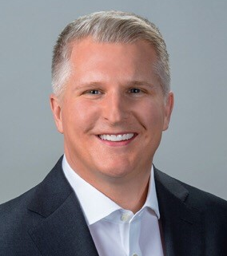


Ryan Kaltenbaugh | Vice President
Vertical Market Solutions &
Federal Government Solutions
Ryan.Kaltenbaugh@Carrier.com
Supporting Department of Defense • Civilian • Intelligence

